Slide 1


Data Analysis
News Categorization
Data source: https://rishabhmisra.github.io/publications/
Data Scientist: Afonso Lima

Slide 2
Topics
Exploratory Data Analysis (EDA)
Classification using supervised learning
Classification using unsupervised learning
Suggestions for improvements

Slide 3
Exploratory Data Analysis (EDA)
The original Dataset has 200.852 rows
After preprocessing phase, that turns the dataset more reliable, the treated dataset has 148.982 rows
The new column considering the joining of “headline” and “short description” columns has 4.771.193 words.

Slide 4
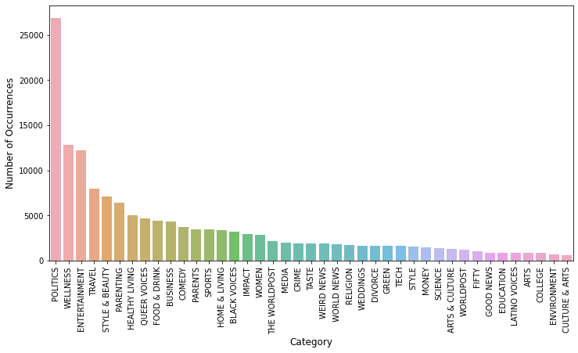
Exploratory Data Analysis (EDA)
Categories
41 Categories
Skewed distribution. Often this affects the classification algorithms
1 - POLITICS 18.06
2 - WELLNESS 8.61
3 - ENTERTAINMENT 8.18
4 - TRAVEL 5.38
5 - STYLE & BEAUTY 4.77
6 - PARENTING 4.30
7 - HEALTHY LIVING 3.40
Total = 52.7% in just 7 of 41 categories

Slide 5
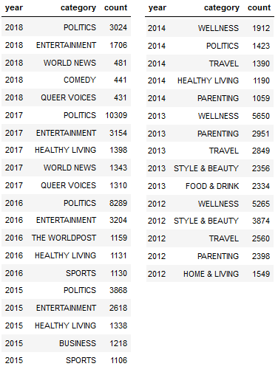
Exploratory Data Analysis (EDA)
Categories by year
Some useful information
Since 2015 POLITICS and ENTERTAINMENT are the TOP two categories.
Until 2014 they didn't appear in the TOP 5 list.
WELLNESS was the TOP category until 2014.
Since 2015 it didn't in the TOP 5 categories.

Slide 6
Exploratory Data Analysis (EDA)
Authors
Top 5 authors
Author | # posts
Lee Moran | 2423
Ron Dicker | 1762
Reuters | 1562
Ed Mazza | 1194
Cole Delbyck | 1140
Some useful information
Total Authors: 148.982
50 Top Authors: 25.02% of the total
100 Top Authors: 35.0% of the total
500 Top Authors: 55.0% of the total

Slide 7
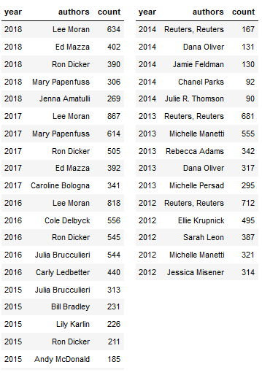
Exploratory Data Analysis (EDA)
Authors by year
Some useful information
Since 2015 Lee Moran is the TOP author with more than 20% publications over the second in the list.
Some authors left TOP 5 list since 2015, although some of them are in the highest overall position (e.g. Reuters)

Slide 8
Classification using supervised learning
Classifier | Accuracy
Naïve Bayes (NB) | 38%
Support Vector Machine (SVM) | 55%
NB with GridSearch + Cross Validation | 56%
SVM with GridSearch + Cross Validation | 56%
NB with NLTK | 49%
Some useful information
Imbalanced classification problem due to skewed distribution.
Due to high number of categories, classification algorithms didn’t have a high accuracy.
GridSearch and Cross Validation helped classifiers to get better tuning parameters settings and improving their accuracies.

Slide 9
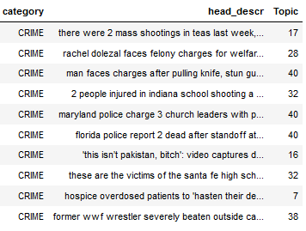
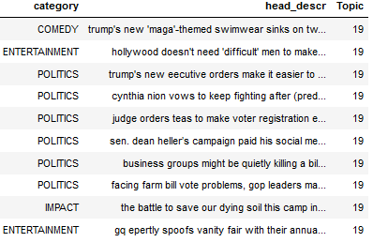
Classification using unsupervised learning
Technique: Non-negative Matrix Factorization
Some useful information
Imbalanced classification problem due to skewed distribution.
Due to high number of categories, classification algorithms didn’t have a good performance.
It is possible to notice that existing categories and topics inferred by techniques aren’t well aligned

Slide 10
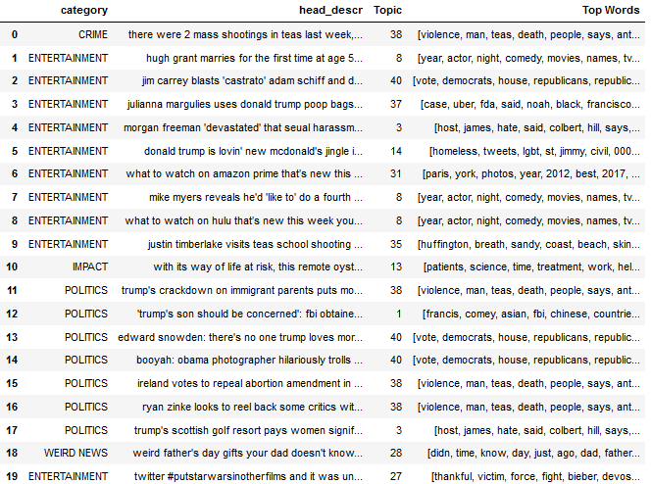
Classification using unsupervised learning
Technique: Latent Dirichlet Allocation (LDA)
Some useful information
Imbalanced classification problem due to skewed distribution.
Due to high number of categories, classification algorithms didn’t have a good performance.
It is possible to notice that existing categories and topics inferred by techniques aren’t well aligned
We can also see that some TOP WORDS aren’t related with existing categories

Slide 11
Suggestions for improvements
Decrease the amount of categories or create sub-categories.
Balance dataset.
To validate data before including in dataset in order to avoid missing data.

Slide 12
THANK YOU

